Slide 1
Day 9
Pointer

Slide 2
Some basics of Variables
When you declare a variable, the computer associates the variable name with a particular location in memory and stores a value there. When you refer to the variable by name in your code, the computer must take two steps:
1.Look up the address that the variable name corresponds to
2.Go to that location in memory and retrieve or set the value it contains
C++ allows us to perform either one of these steps independently on a variable with the & and * operators:
1.&x evaluates to the address of x in memory.
2.*( &x ) takes the address of x and dereferences it – it retrieves the value at that location in memory. *( &x ) thus evaluates to the same thing as x.

Slide 3
Motivation for Pointers
Memory addresses, or pointers, allow us to manipulate data much more flexibly; manipulating the memory addresses of data can be more efficient than manipulating the data itself. Just a taste of what we’ll be able to do with pointers:
More flexible pass-by-reference
Manipulate complex data structures efficiently, even if their data is scattered in different memory locations
Use polymorphism – calling functions on data without knowing exactly what kind of data it is

Slide 4
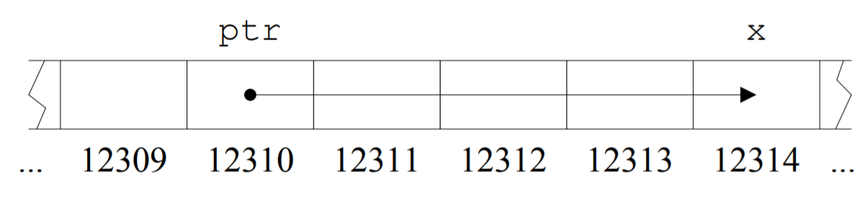
The Nature of Pointers
Pointers are just variables storing values– but those values happen to be memory addresses, usually addresses of other variables. A pointer that stores the address of some variable x is said to point to x. We can access the value of x by dereferencing the pointer.
As with arrays, it is often helpful to visualize pointers by using a row of adjacent cells to represent memory locations, as below. Each cell represents 1 block of memory. The dot-arrow notation indicates that ptr “points to” x – that is, the value stored in ptr is 12314, x’s memory address.

Slide 5
Declaring Pointers
To declare a pointer variable named ptr that points to an integer variable named x: int * ptr = &x;
The general scheme for declaring pointers is:
data_type * pointer_name ;
pointer name is then a variable of type data type * – a “pointer to a data type value.”

Slide 6
Using Pointer Values
Once a pointer is declared, we can dereference it with the * operator to access its value:
cout << * ptr;
Without the * operator, the identifier x refers to the pointer itself, not the value it points to:
cout << ptr; // Outputs the memory address of x in base 16

Slide 7
Passing pointers as argument to Functions
Just like any other data type, we can pass pointers as arguments to functions. The same way we’d say void func(int x) {...}, we can say void func(int *x){...}.

Slide 8
NULL pointers
Some pointers do not point to valid data; dereferencing such a pointer is a runtime error. Any pointer set to 0 is called a null pointer, and since there is no memory location 0, it is an invalid pointer. One should generally check whether a pointer is null before dereferencing it. Pointers are often set to 0 to signal that they are not currently valid.

Slide 9
The many faces of * and &
The usage of the * and & operators with pointers/references can be confusing. The * operator is used in two different ways:
When declaring a pointer, * is placed before the variable name to indicate that the variable being declared is a pointer – say, a pointer to an int or char, not an int or char value.
When using a pointer that has been set to point to some value, * is placed before the pointer name to dereference it – to access or set the value it points to.
A similar distinction exists for &, which can be used either
to indicate a reference data type (as in int &x;), or
to take the address of a variable (as in int *ptr = &x;).

Slide 10
Pointers and Arrays
The name of an array is actually a pointer to the first element in the array. Writing myArray[3] tells the compiler to return the element that is 3 away from the starting element of myArray.
This explains why arrays are always passed by reference: passing an array is really passing a pointer.
This also explains why array indices start at 0: the first element of an array is the element that is 0 away from the start of the array.

Slide 11
Pointer Arithmetic
Pointer arithmetic is a way of using subtraction and addition of pointers to move around between locations in memory, typically between array elements. Adding an integer n to a pointer produces a new pointer pointing to n positions further down in memory.
long arr[ ] = {6, 0, 9, 6};
long *ptr = arr;
ptr++;

Slide 12
Pointer Arithmetic
When we add 1 to ptr in line 3, we don’t just want to move to the next byte in memory, since each array element takes up multiple bytes; we want to move to the next element in the array. The C++ compiler automatically takes care of this, using the appropriate step size for adding to and subtracting from pointers. Thus, line 3 moves ptr to point to the second element of the array.
Similarly, we can add/subtract two pointers: ptr2 - ptr gives the number of array elements between ptr2 and ptr (2). All addition and subtraction operations on pointers use the appropriate step size.

